Slide 1
Genetic Programming

Slide 2
GP quick overview
Developed: USA in the 1990’s
Early names: J. Koza
Typically applied to:
  machine learning tasks (prediction, classification…)
Attributed features:
  competes with neural nets and alike
  needs huge populations (thousands)
  slow
Special:
  non-linear chromosomes: trees, graphs
  mutation possible but not necessary (disputed!)

Slide 3
Introductory example: credit scoring
Bank wants to distinguish good from bad loan applicants
Model needed that matches historical data
ID | No of children | Salary | Marital status | OK?
ID-1 | 2 | 45000 | Married | 0
ID-2 | 0 | 30000 | Single | 1
ID-3 | 1 | 40000 | Divorced | 1
…

Slide 4
Introductory example: credit scoring
A possible model:
IF (NOC = 2) AND (S > 80000) THEN good ELSE bad
In general:
IF formula THEN good ELSE bad
Only unknown is the right formula, hence
Our search space (phenotypes) is the set of formulas
Natural fitness of a formula: percentage of well classified cases of the model it stands for
Natural representation of formulas (genotypes) is: parse trees

Slide 5
Introductory example: credit scoring
IF (NOC = 2) AND (S > 80000) THEN good ELSE bad
can be represented by the following tree
AND
=
>
NOC
2
S
80000

Slide 6
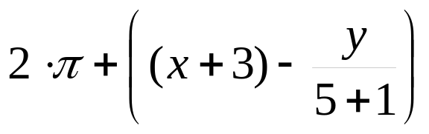
Tree based representation
Trees are a universal form, e.g. consider
Arithmetic formula
Logical formula
Program
(x ∧ true) → (( x ∨ y ) ∨ (z ↔ (x ∧ y)))
i =1;
while (i < 20)
{
i = i +1
}

Slide 7
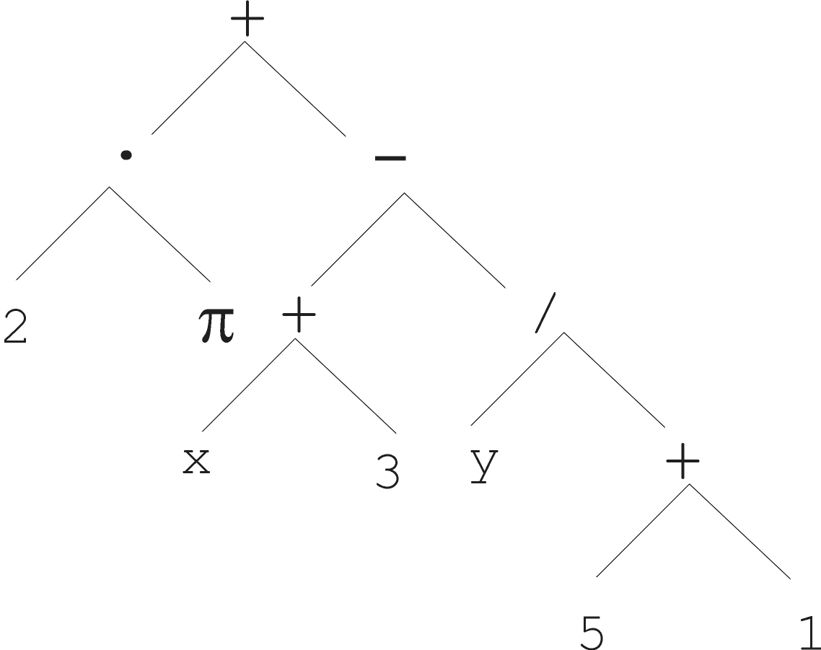
Tree based representation

Slide 8
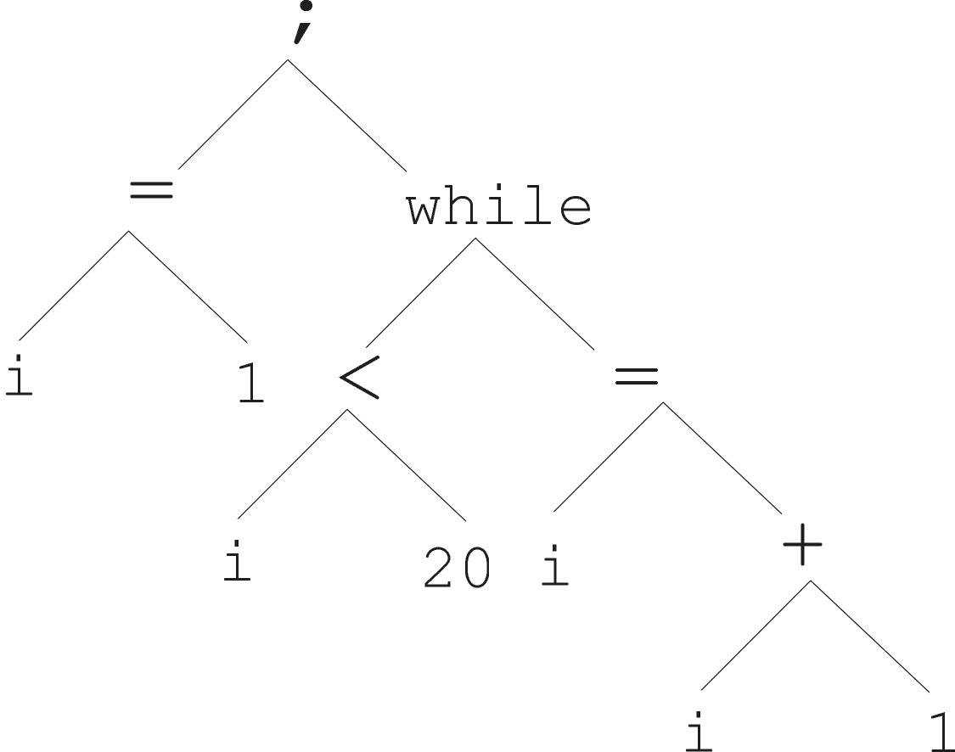
Tree based representation
i =1;
while (i < 20)
{
i = i +1
}

Slide 9
Tree based representation
In GA, ES, EP chromosomes are linear structures (bit strings, integer string, real-valued vectors, permutations)
Tree shaped chromosomes are non-linear structures
In GA, ES, EP the size of the chromosomes is fixed
Trees in GP may vary in depth and width

Slide 10
Tree based representation
Symbolic expressions can be defined by
  Terminal set T
  Function set F (with the arities of function symbols)
Adopting the following general recursive definition:
  Every t ∈ T is a correct expression
  f(e₁, …, e_{n}) is a correct expression if f ∈ F, arity(f)=n and e₁, …, e_{n} are correct expressions
  There are no other forms of correct expressions

Slide 11
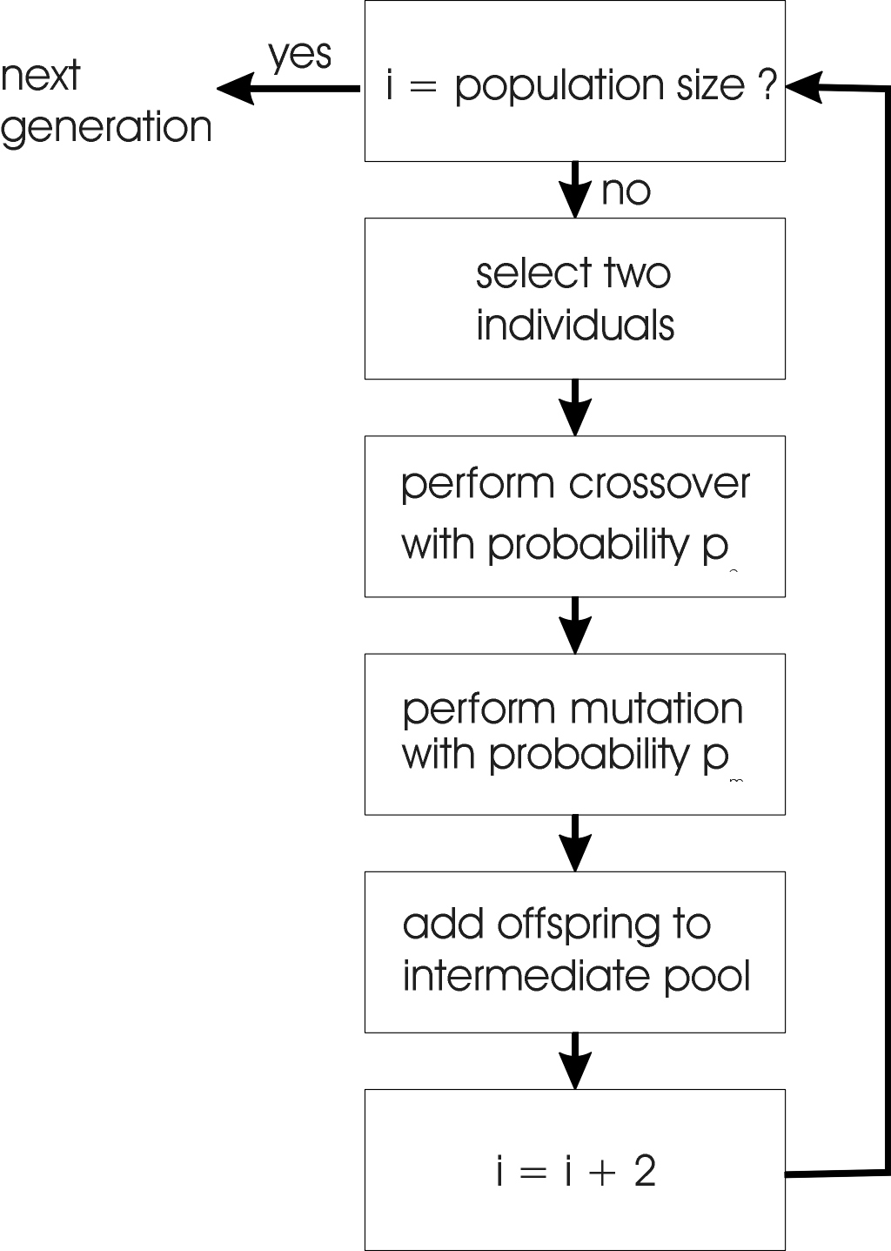
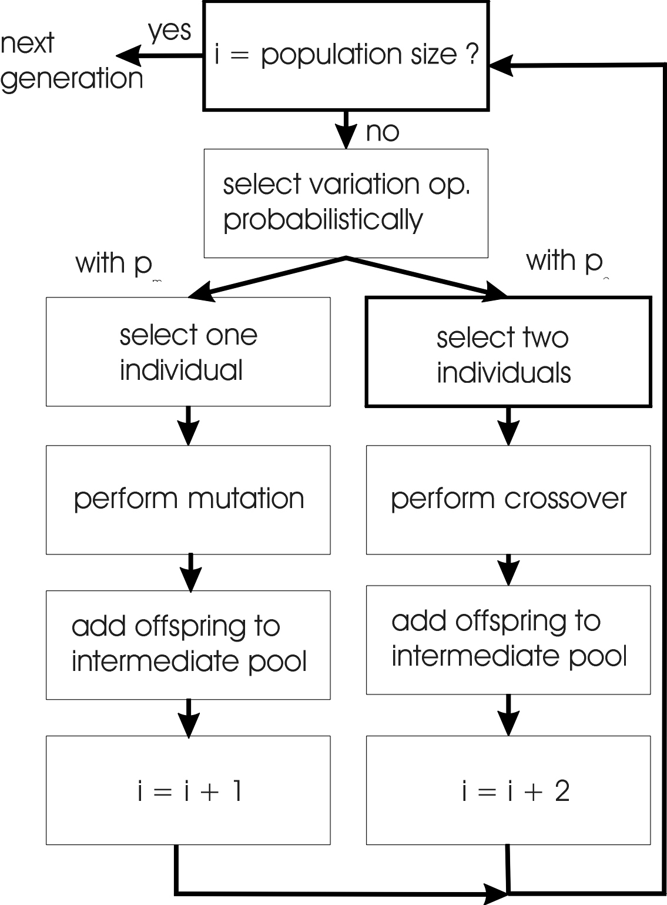
GA flowchart
GP flowchart

Slide 12
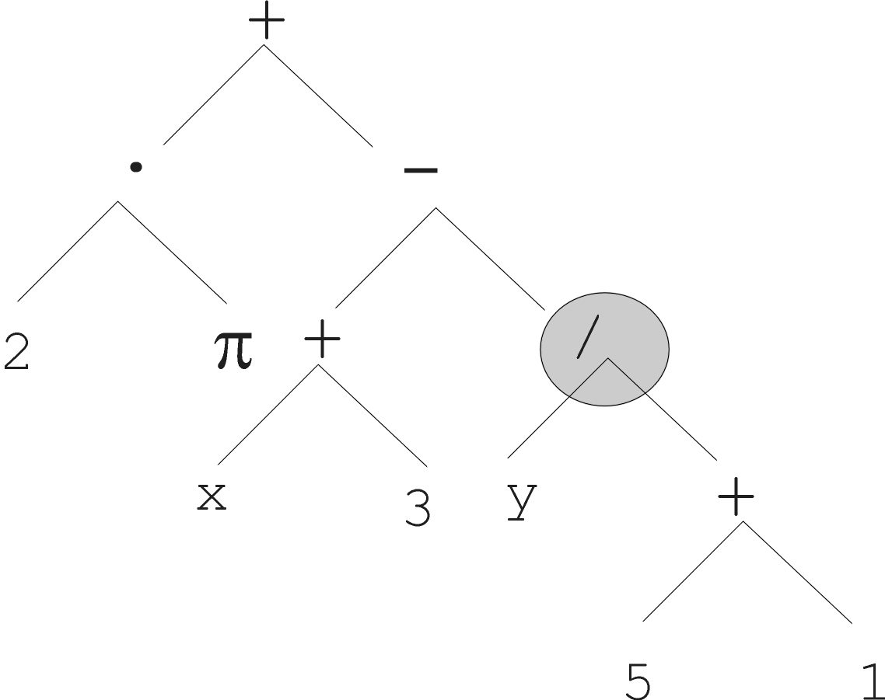
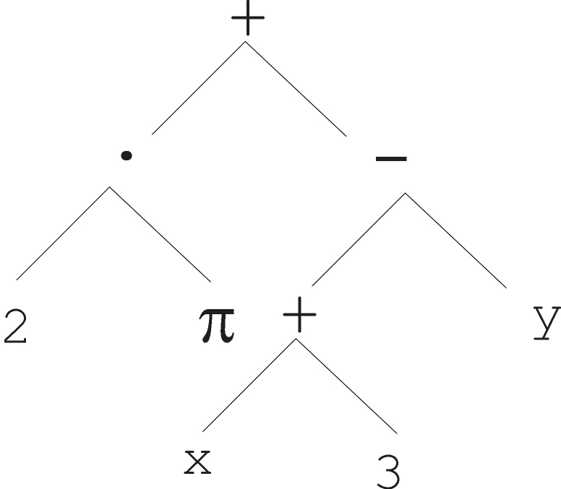
Mutation
Most common mutation: replace randomly chosen subtree by randomly generated tree

Slide 13
Mutation cont’d
Mutation has two parameters:
  Probability p_{m} to choose mutation vs. recombination
  Probability to chose an internal point as the root of the subtree to be replaced
Remarkably p_{m} is advised to be 0 (Koza’92) or very small, like 0.05 (Banzhaf et al. ’98)
The size of the child can exceed the size of the parent

Slide 14
Recombination
Most common recombination: exchange two randomly chosen subtrees among the parents
Recombination has two parameters:
  Probability p_{c} to choose recombination vs. mutation
  Probability to chose an internal point within each parent as crossover point
The size of offspring can exceed that of the parents

Slide 15
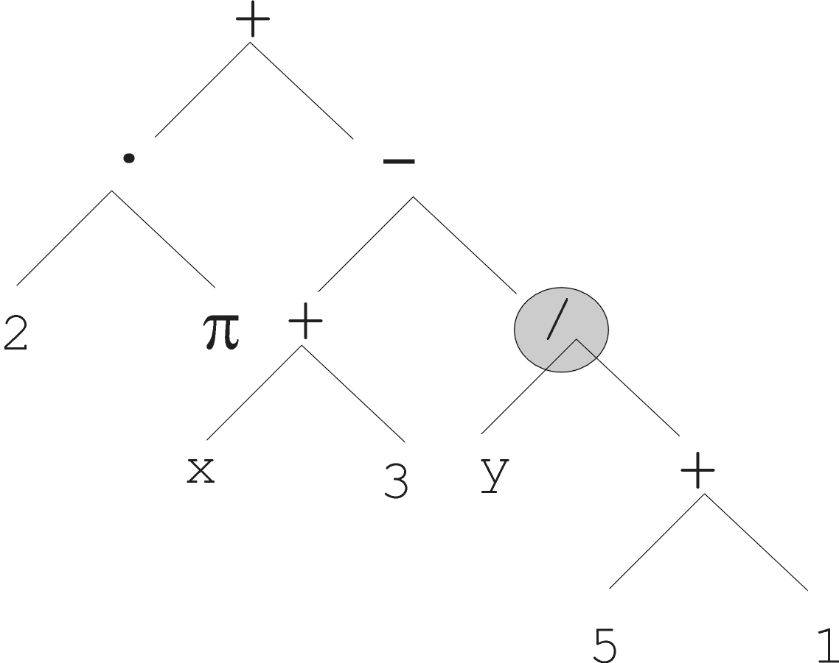
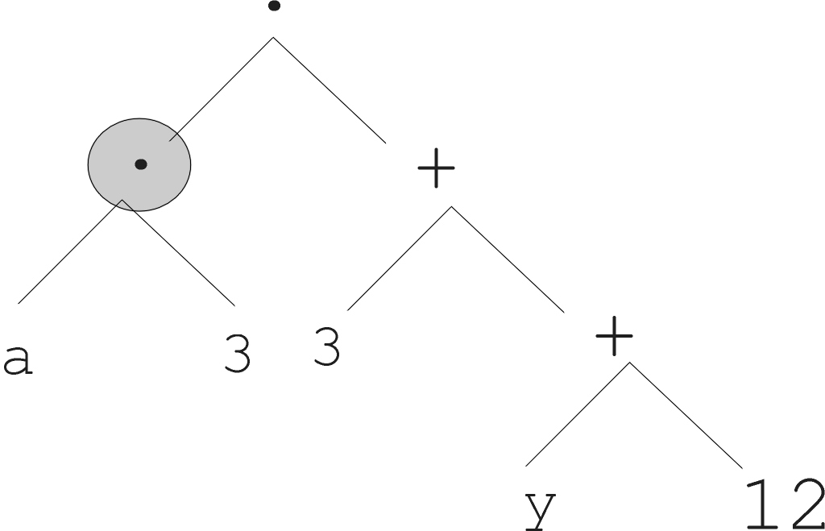
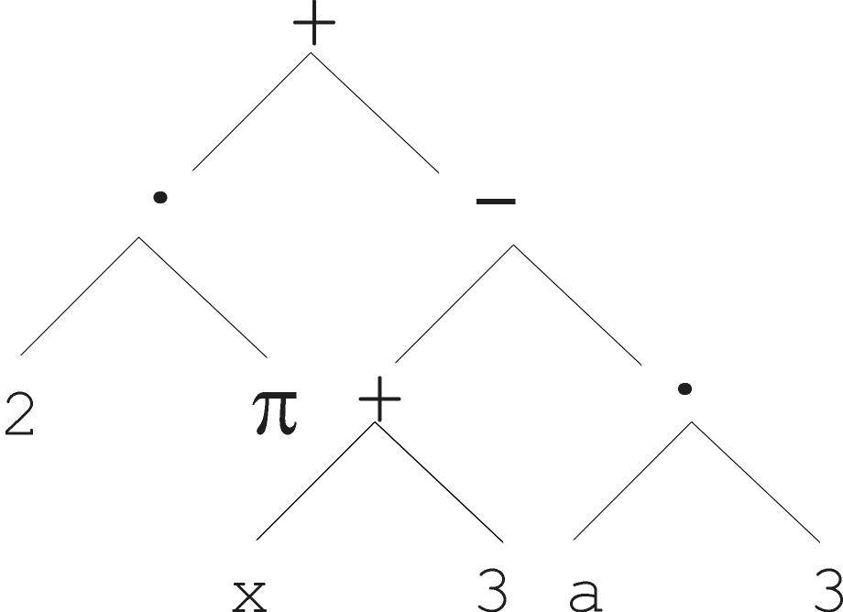
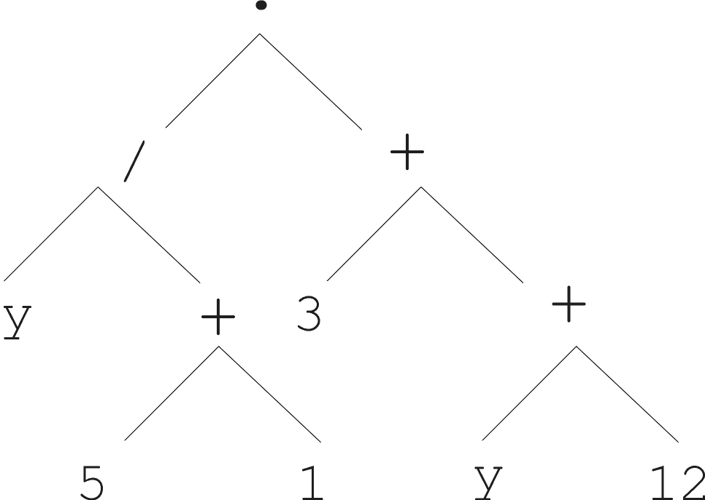
Parent 1
Parent 2
Child 1
Child 2

Slide 16
Selection
Parent selection typically fitness proportionate
Over-selection in very large populations
  rank population by fitness and divide it into two groups:
  group 1: best x% of population, group 2 other (100-x)%
  80% of selection operations chooses from group 1, 20% from group 2
  for pop. size = 1000, 2000, 4000, 8000 x = 32%, 16%, 8%, 4%
  motivation: to increase efficiency, %’s come from rule of thumb
Survivor selection:
  Typical: generational scheme (thus none)
  Recently steady-state is becoming popular for its elitism

Slide 17
Initialisation
Maximum initial depth of trees D_{max} is set
Full method (each branch has depth = D_{max}):
  nodes at depth d < D_{max} randomly chosen from function set F
  nodes at depth d = D_{max} randomly chosen from terminal set T
Grow method (each branch has depth ≤ D_{max}):
  nodes at depth d < D_{max} randomly chosen from F ∪ T
  nodes at depth d = D_{max} randomly chosen from T
Common GP initialisation: ramped half-and-half, where grow & full method each deliver half of initial population

Slide 18
Bloat
Bloat = “survival of the fattest”, i.e., the tree sizes in the population are increasing over time
Ongoing research and debate about the reasons
Needs countermeasures, e.g.
  Prohibiting variation operators that would deliver “too big” children
  Parsimony pressure: penalty for being oversized

Slide 19
Problems involving “physical” environments
Trees for data fitting vs. trees (programs) that are “really” executable
Execution can change the environment → the calculation of fitness
Example: robot controller
Fitness calculations mostly by simulation, ranging from expensive to extremely expensive (in time)
But evolved controllers are often to very good

Slide 20
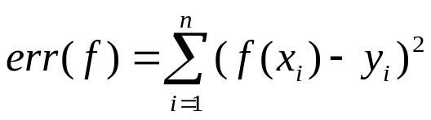
Example application: symbolic regression
Given some points in R², (x₁, y₁), … , (x_{n}, y_{n})
Find function f(x) s.t. ∀i = 1, …, n : f(x_{i}) = y_{i}
Possible GP solution:
  Representation by F = {+, -, /, sin, cos}, T = R ∪ {x}
  Fitness is the error
  All operators standard
  pop.size = 1000, ramped half-half initialisation
  Termination: n “hits” or 50000 fitness evaluations reached (where “hit” is if | f(x_{i}) – y_{i} | < 0.0001)

Slide 21
Discussion
Is GP:
The art of evolving computer programs ?
Means to automated programming of computers?
GA with another representation?

Slide 22
Introduction to GP based identification
System
Model
Model structure
Model parameters
Black-box models
Model-selection
Known parameters
Based on prior knowledge
Black-box modeling
A modellező választ
modell struktúrát
Identification
From measured data
with some optimization

Slide 23
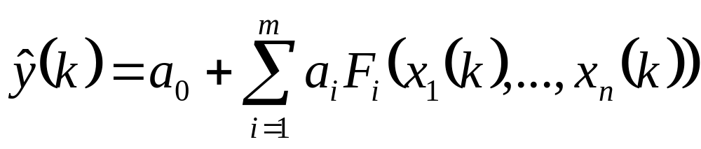
Linear in parameters model
The original GP generates models that are nonlinear in their parameters
Linear in parameters model
The parameters can be estimated by LS

Slide 24
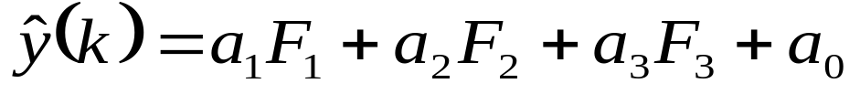
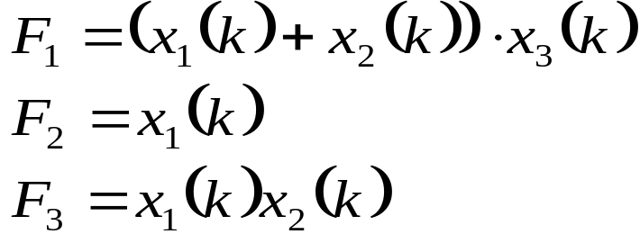
Model representation
+
*
+
+
x₃
x₁
*
x₁
x₂
F₂
x₁
x₂
F₃
F₁

Slide 25

OLS
With orthogonal LS we can estimate the contribution
The useless branches will be deleted
+
+
*
+
x₁
*
+
x₃
x₁
*
F₁
x₁
x₂
x₁
x₂
F₂
x₁
x₂
F₂
F₃
F₁

Slide 26
Example: system-identification
simulation
4
3
2
(y) + 4% noise
1
(u)
0
-1
-2
0
20
40
60
80
100
Result of GP

Slide 27
Improvement of the OLS
10-10 runs with max. 1000 evaluations
Method | 1 | 2 | 3
Not exact solution from 10 | 10 | 4 | 3
exact solution from 10 | 0 | 6 | 7
Avarage runtime to find a solution | 1000 | 880 | 565
: No penaly on the size of the tree
: Penaly on the size of the tree
: penaly on the size of the tree + OLS

Slide 28
Conclusions
Model structure identification is a not trivial task
GP can be used for this purpose
Linear in parameters models are ideal for GP based structure exploration
It is useful to apply OLS to regularize the tree

